Slide 1


Slide 2
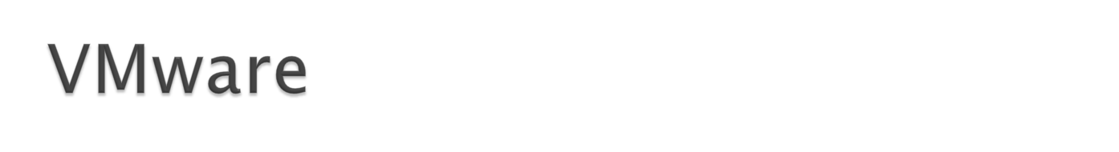
vCloud Suite
VMware vCloud suite helps you build and manage a VMware vSphere based private cloud.
It helps improve efficiency, agility and control for IT organizations.
Supports for powerful server virtualization.
Allows Virtualization of traditional and next-generation applications with the industry leading x86 server virtualization platform.

Slide 3
vCloud Suite
Helps manage infrastructure and applications for vSphere environment.
Allows perform predictive analytics and an integrated approach to performance, capacity and configuration management.
Automate provisioning and delivery of infrastructure, applications and custom IT services for vSphere environments through a self-service portal and catalog.

Slide 4
vCloud Suite
Align IT spending with business priorities via virtualized infrastructure service costing, usage metering and service pricing for vSphere environments.
Protect applications and simplify disaster recovery with one-click automated orchestration and non-disruptive testing of centralized recovery plans.

Slide 5
vCloud Suite Components
vSphere - is the leading server virtualization platform with consistent management for virtual data centers.
IT virtualizes your x86 server resources and aggregate them into logical pools for allocation of multiple workloads.
Reduce the complexity of back-end storage systems and enable the most efficient storage utilization in cloud infrastructures.

Slide 6
vCloud Suite – vSphere
Maximize the benefits of your virtual data center with unified easy-to-use operations management.
Safely automate infrastructure management with guided remediation and customizable actions, while always staying in control.
Maximize uptime across your cloud infrastructure, reducing unplanned downtime and eliminating planned downtime for server and storage maintenance.

Slide 7
vCloud Suite- vSphere
Provides network services optimization for the virtual environment, along with simplified administration and management.
Protect your data and applications with the industry’s most secure “bare-metal” server virtualization platform.
Provide choice on how to consume your cloud environment.

Slide 8
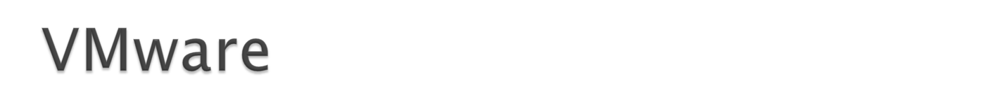
vSphere Components
VMware ESXi
  A virtualization layer that runs on physical servers that abstracts processor, memory, storage, and resources into multiple virtual machines.
VMware vCenter Server
  The central point for configuring, provisioning, and managing virtualized IT environments. It provides essential datacenter services such as access control, performance monitoring, and alarm management.
VMware vSphere Client
  An interface that enables users to connect remotely to vCenter Server or ESXi from any Windows PC.
VMware vSphere Web Client
  A Web interface that enables users to connect remotely to vCenter Server from a variety of Web browsers and operating systems.

Slide 9
vSphere Components
VMware vSphere SDKs
  Feature that provides standard interfaces for VMware and third-party solutions to access VMware vSphere.
vSphere Virtual Machine File System (VMFS)
  A high performance cluster file system for ESXi virtual machines.
vSphere Virtual SMP
  Enables a single virtual machine to use multiple physical processors simultaneously.
vSphere vMotion
  Enables the migration of powered-on virtual machines from one physical server to another with zero down time, continuous service availability, and complete transaction integrity.
  Migration with vMotion cannot be used to move virtual machines from one datacenter to another.

Slide 10
vSphere Components
vSphere Storage vMotion
  Enables the migration of virtual machine files from one datastore to another without service interruption. You can place the virtual machine and all its disks in a single location, or select separate locations for the virtual machine configuration file and each virtual disk. The virtual machine remains on the same host during Storage vMotion.
  Migration with Storage vMotion lets you move the virtual disks or configuration file of a virtual machine to a new datastore while the virtual machine is running. Migration with Storage vMotion enables you to move a virtual machine's storage without any interruption in the availability of the virtual machine.
vSphere High Availability (HA)
  A feature that provides high availability for virtual machines. If a server fails, affected virtual machines are restarted on other available servers that have spare capacity.
vSphere Distributed Resource Scheduler (DRS)
  Allocates and balances computing capacity dynamically across collections of hardware resources for virtual machines. This feature includes distributed power management (DPM) capabilities that enable a datacenter to significantly reduce its power consumption.

Slide 11
vSphere Components
vSphere Storage DRS
  Allocates and balances storage capacity and I/O dynamically across collections of datastores. This feature includes management capabilities that minimize the risk of running out of space and the risk of I/O bottlenecks slowing the performance of virtual machines.
vSphere Fault Tolerance
  Provides continuous availability by protecting a virtual machine with a copy. When this feature is enabled for a virtual machine, a secondary copy of the original, or primary, virtual machine is created. All actions completed on the primary virtual machine are also applied to the secondary virtual machine. If the primary virtual machine becomes unavailable, the secondary machine becomes immediately active.
vSphere Distributed Switch (VDS)
  A virtual switch that can span multiple ESXi hosts, enabling significant reduction of on-going network maintenance activities and increasing network capacity. This increased efficiency enables virtual machines to maintain consistent network configuration as they migrate across multiple hosts.
Host Profiles
  A feature that simplifies host configuration management through user-defined configuration policies.

Slide 12
vSphere Components
vRealize Operations - Use intuitive and customizable dashboards, views and reports for at-a-glance access to the data required for informed, intelligent operational decisions and capacity management.
Predictive analytics and smart alerts correlate multiple symptoms into meaningful warnings of potential problems

Slide 13
vSphere Components – vRealize Operations
Take advantage of out-of-the-box configuration and compliance policies or customize your own.
Policy-based automation lets you proactively enforce configuration standards, detect configuration drift early and automatically remediate violations of IT policies.

Slide 14
vSphere Components – vRealize Automation
Earlier known as vCloud automation center.
Deliver infrastructure, application and custom services through a unified IT service catalog.
Meet specific business needs at the right service level with personalized, policy-based governance.
Automate and accelerate IT service delivery.

Slide 15
vSphere Components – vRealize Orchestrator
Provides the capability to create workflows that automate activities such as provisioning virtual machine, performing scheduled maintenance, initiating backups, and many others.

Slide 16
vSphere Components – vSphere Big Data Extensions
Simplifies running Big Data workloads on the vSphere platform.
vSphere Components – vSphere Replication
Provides replication, at the individual virtual machine disk level, between datastores hosted on any storage.

Slide 17

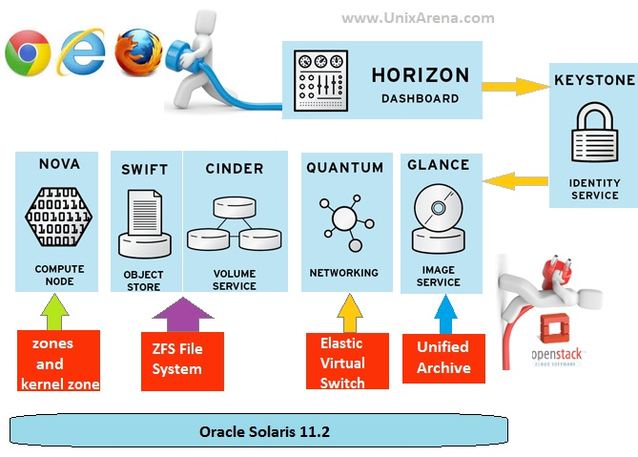

Slide 18
Everything is written in python.
End users can interact through a common web interface (Horizon) or directly to each service through their API
All services authenticate through a common source.
Individual services interact with each other through their public APIs.

Slide 19
Identity (“Keystone”)
Keystone provides a single point of integration for OpenStack policy, catalog, token and authentication.
keystone handles API requests as well as providing configurable catalog, policy, token and identity services.
Standard back-ends include LDAP or SQL, as well as Key Value Stores (KVS).
Better use this as a point of customization for current authentication services.

Slide 20
Dashboard (“Horizon”)
Django application that users can access in their web browser
Communicates with each OpenStack service through their API (and sometimes their admin API)

Slide 21
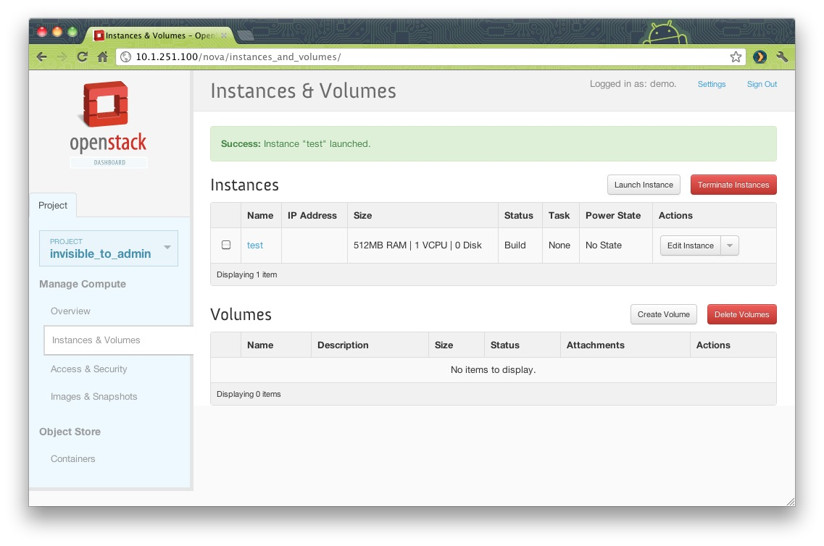

Slide 22
Object Storage (“Swift”)
Stores and serves objects (files)
Employs object level replication to safeguard data
Accepts client requests via Object store API or HTTP from clients through swift-proxy
Maintains distributed account and container databases
Stores objects according the ring layout on filesystem with extended attributes (XFS, EXT4, etc.)

Slide 23
Image Service (“Glance”)
glance-api accepts Image API calls for image discovery, image retrieval and image storage.
glance-registry stores, processes and retrieves metadata about images (size, type, etc.).
Database to store the image metadata.
A storage repository for the actual image files. In many deployments, this is OpenStack Swift

Slide 24
Block Storage (“Cinder”)
cinder-api accepts API requests and routes them to cinder-volume for action.
cinder-volume acts upon the requests by reading or writing to the Cinder database to maintain state, interacting with other processes (like cinder-scheduler) through a message queue and directly upon block storage providing hardware or software. It can interact with a variety of storage providers through a driver architecture. Currently, there are drivers for IBM, SolidFire, NetApp, Nexenta, Zadara, linux iSCSI and other storage providers.
Much like nova-scheduler, the cinder-scheduler daemon picks the optimal block storage provider node to create the volume on.

Slide 25
Networking (“Quantum”)
quantum-server accepts API requests and then routes them to the appropriate quantum plugin for action.
Quantum ships with plugins and agents for:
  Cisco virtual and physical switches
  Nicira NVP product
  NEC OpenFlow products
  Open vSwitch
  Linux bridging
  Ryu Network Operating System
  Midokua
The common agents are L3 (layer 3), DHCP (dynamic host IP addressing) and the specific plug-in agent.

Slide 26
Compute (“Nova”)
nova-api accepts and responds to end user compute API calls.
Supports OpenStack Compute API, Amazon's EC2 API and a special Admin API (for privileged users to perform administrative actions).
Initiates most of the orchestration activities (such as running an instance)
Enforces some policy (mostly quota checks)
Authentication is handled through middleware before getting to this daemon

Slide 27
Nova Compute
The nova-compute process is primarily a worker daemon that creates and terminates virtual machine instances via hypervisor's APIs (XenAPI for XenServer/XCP, libvirt for KVM or QEMU, VMwareAPI for VMware, etc.).
The process by which it does so is fairly complex but the basics are simple: accept actions from the queue and then perform a series of system commands (like launching a KVM instance) to carry them out while updating state in the database.

Slide 28
Nova Scheduler
The nova-schedule process is conceptually the simplest piece of code in OpenStack Nova: take a virtual machine instance request from the queue and determines where it should run.

Slide 29

System Center 2012 R2
Notes:
12/10/21 20:18
© 2010 Microsoft Corporation. All rights reserved. Microsoft, Windows, Windows Vista and other product names are or may be registered trademarks and/or trademarks in the U.S. and/or other countries.
The information herein is for informational purposes only and represents the current view of Microsoft Corporation as of the date of this presentation. Because Microsoft must respond to changing market conditions, it should not be interpreted to be a commitment on the part of Microsoft, and Microsoft cannot guarantee the accuracy of any information provided after the date of this presentation.
MICROSOFT MAKES NO WARRANTIES, EXPRESS, IMPLIED OR STATUTORY, AS TO THE INFORMATION IN THIS PRESENTATION.

Slide 30

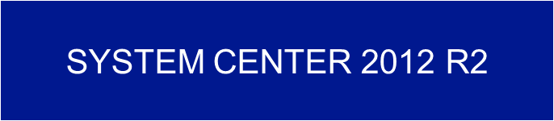

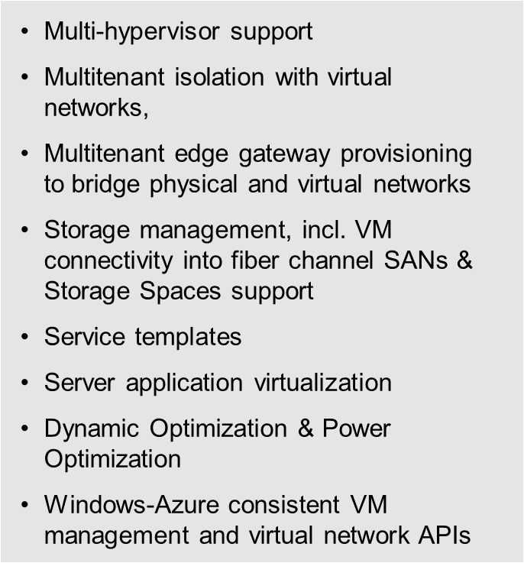
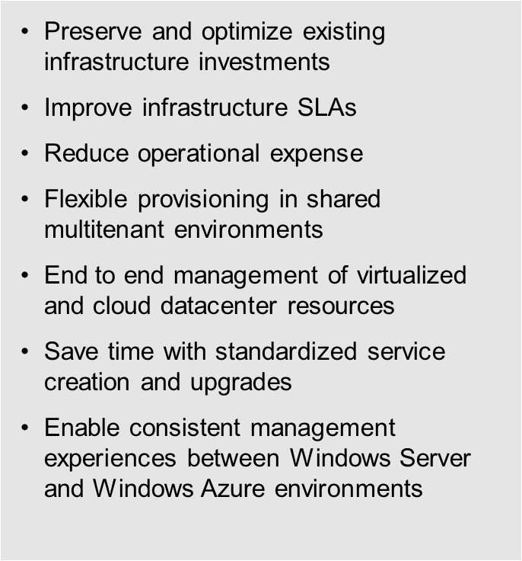

Slide 31

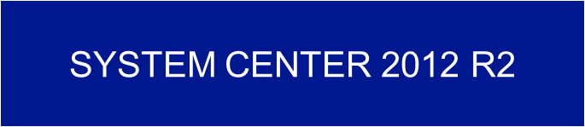

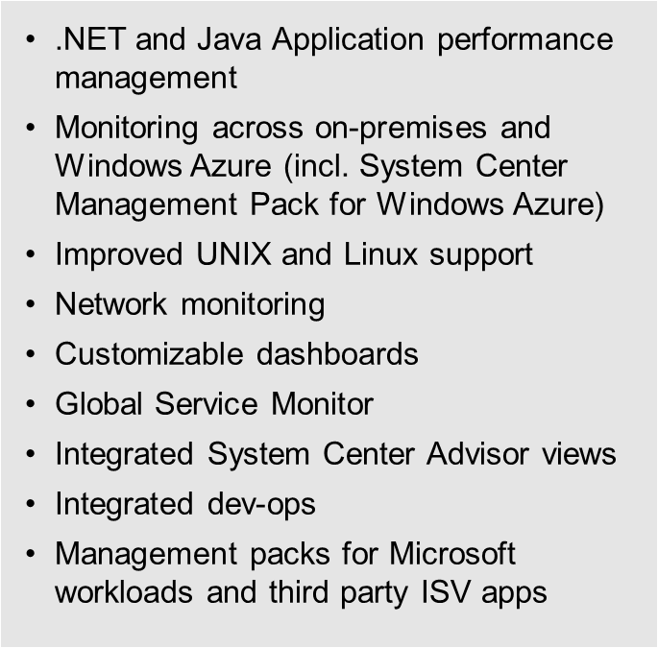
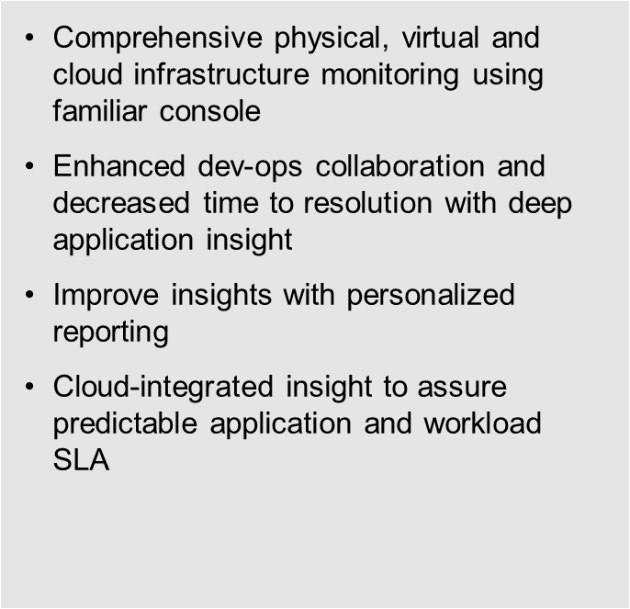

Slide 32



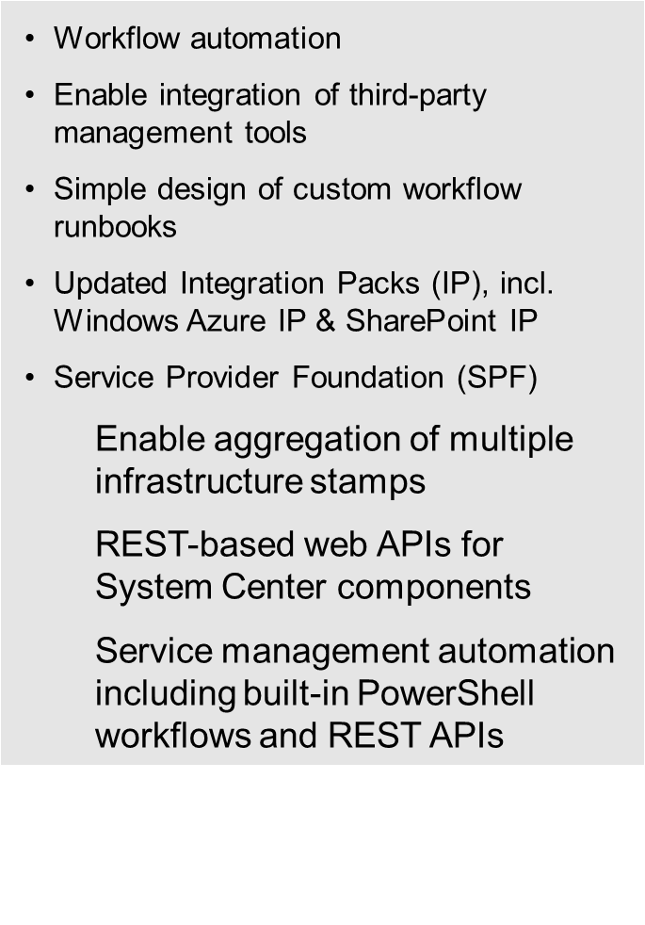
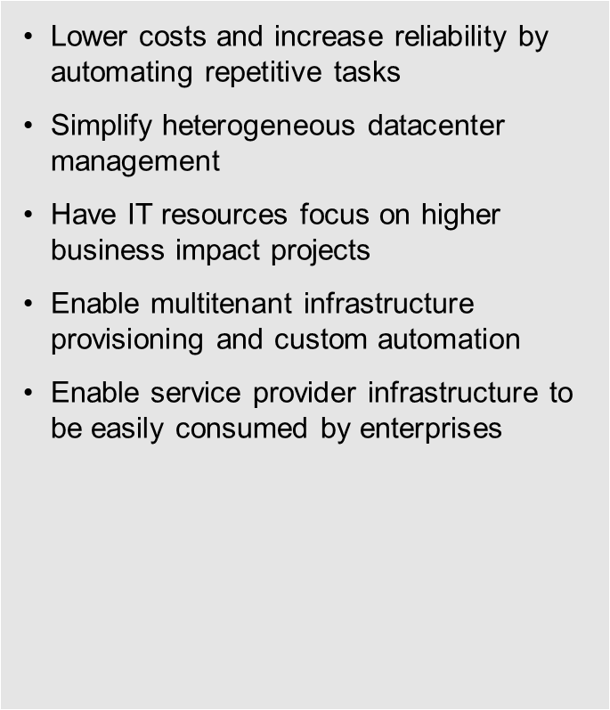

Slide 33



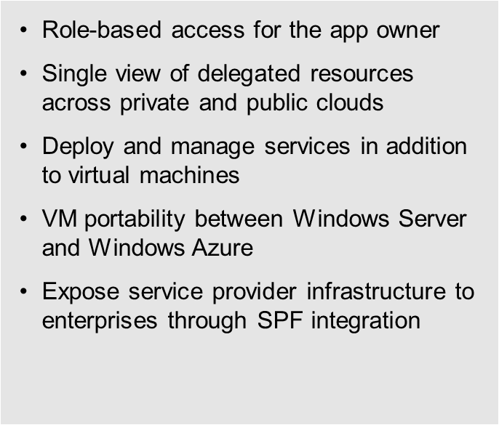
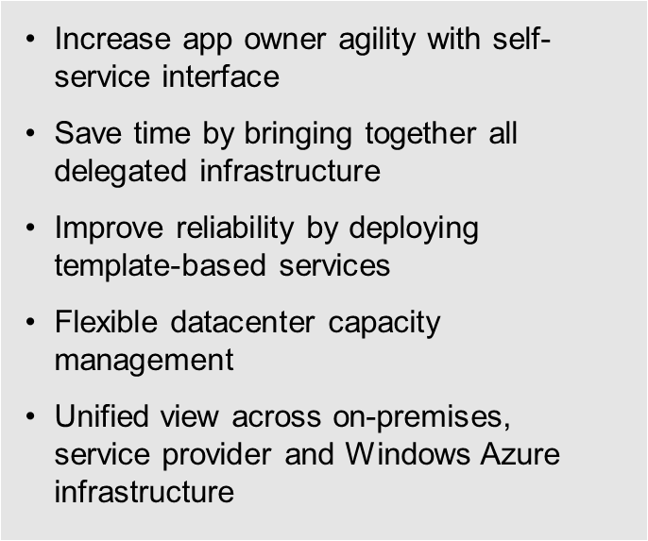

Slide 34

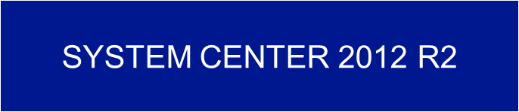

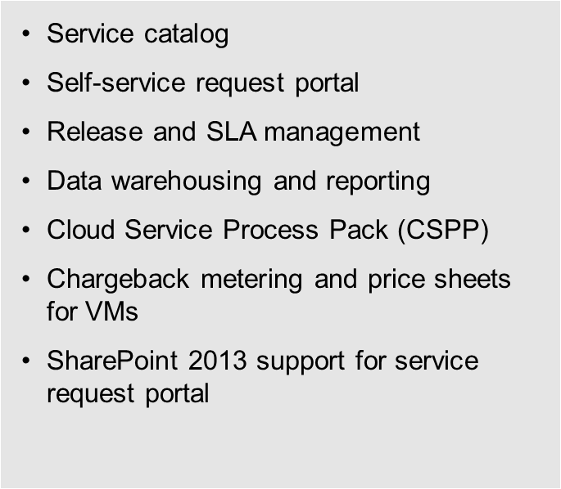
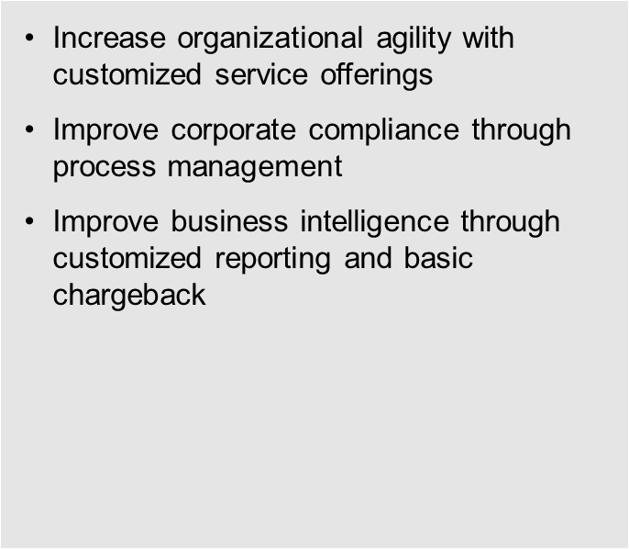

Slide 35

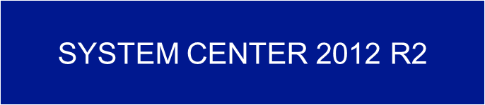

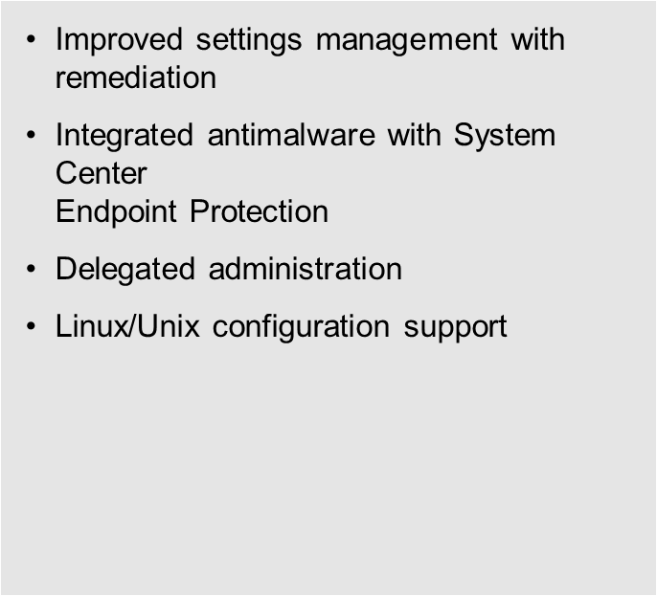
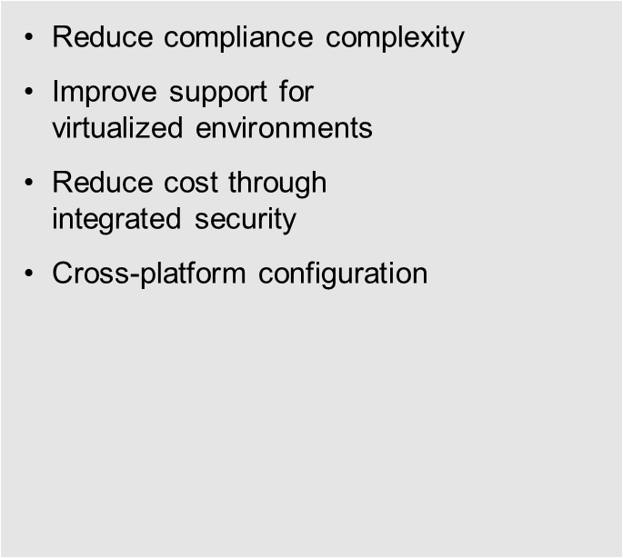

Slide 36

